Slide 1
Automated trading strategy
MSDS 8310 Project 2
Fall 2017
Matt Baldree
Notes:
Team Members: I
Confirm you have turned in your project documents (emailed them to me): yes
Project Description: In this project, leading and lagging financial technical indicators typically used for stock assets were applied to cryptocurrency Bitcoin historical close price to determine trading strategy. Trading strategy was then used to buy, sell, and hold asset and the results were compared to a buy and hold strategy. The new labeled trading strategy data set was then learned by a stochastic gradient boosting algorithm, XGBoost. Accuracy, feature importance, and a plot of a single decision tree are provided as well.
• Expected audience: cryptocurrency investors
• What you are trying to solve/analyze: predict favorable buying and selling conditions
• What models you used: 2hr and daily bitcoin closing price coinbase dataset
• How you will measure success/compare models: accuracy
Walk through of results – Presentation
• Make sure you finish with what you personally learned from doing this project

Slide 2
Questions
When should I enter or exit a cryptocurrency bitcoin market?
Is it a good time to buy?
Is it a good time to sell?

Slide 3
challenges
Bitcoin is a volatile asset
Difficult to find granular time series data
No labeled data available

Slide 4
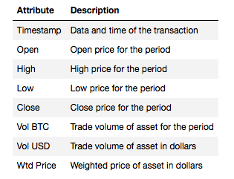
Coinbase dataset
Kaggle dataset
1 minute granularity
Resample for 2 hr and daily closing price

Slide 5
Label data
Leverage technical indicators and algorithm to indicate trading strategy (buy, sell, do nothing)
Validate trading strategy against a buy and hold strategy and visual inspection

Slide 6
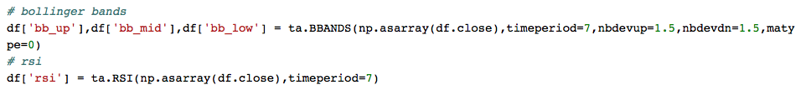
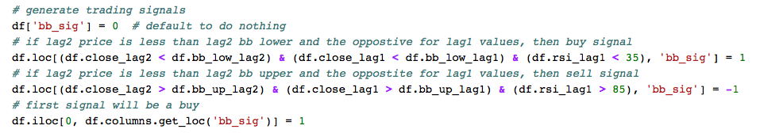
Bollinger band (BB) and relative strength indicator (RSI) Trading strategy algorithm

Slide 7
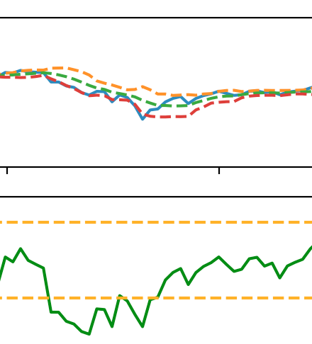
Close Price
Bollinger Band (High, Middle, Low)
RSI with
Oversold and Overbought Indicators

Slide 10
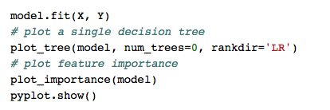
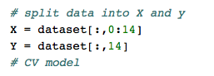
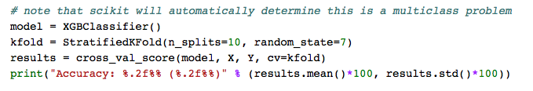
Learn signals with stochastic gradient boost algorithm (xgboost)

Slide 12
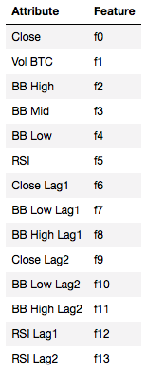

Slide 13
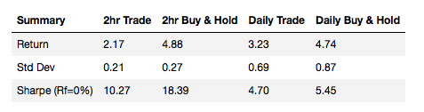
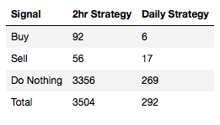
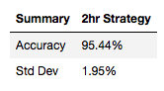
results

Slide 14
analysis
Didn’t want to game the trading to beat buy and hold
RSI is clearly more important feature (4.2x)
2 hour data produced 12x more data points for learning
Classification accuracy was 95.4% >> 50% naïve
Volume plays a key role (21%)

Slide 15
conclusion
This project was able to label a Bitcoin dataset with a trading algorithm built on a combination of multiple technical indicators.
The labeled data was used to successfully train a stochastic gradient boost algorithm, `XGBOOST` yielding a 95.4% accuracy.
RSI proved to be the more important technical indicator in classifying trading strategy. These results are limited to this dataset.

Slide 16
Future work
adding additional technical indicators to determine which ones provide the most value in determining trading strategy,
incorporating other cryptocurrency price history to determine if feature importance is the same,
automate data acquisition, labeling, and training of algorithm,
develop a webservice to provide trading strategy for given date range.

